Slide 1
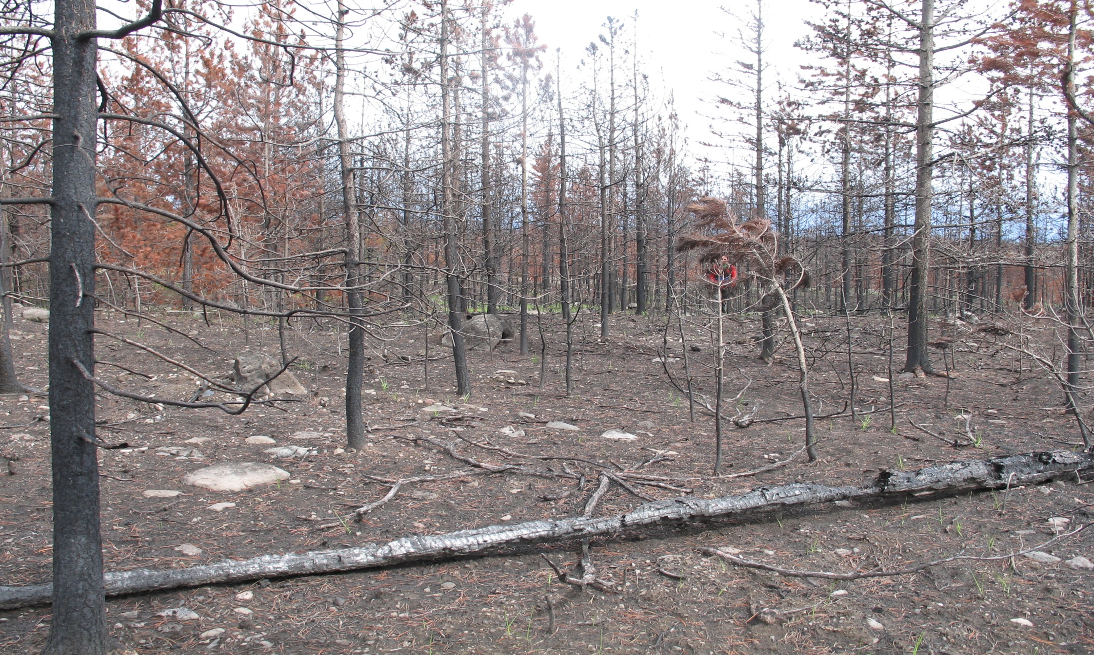
Forests For Tomorrow
Strategic Plan
Allan Powelson, September 2013

Slide 2
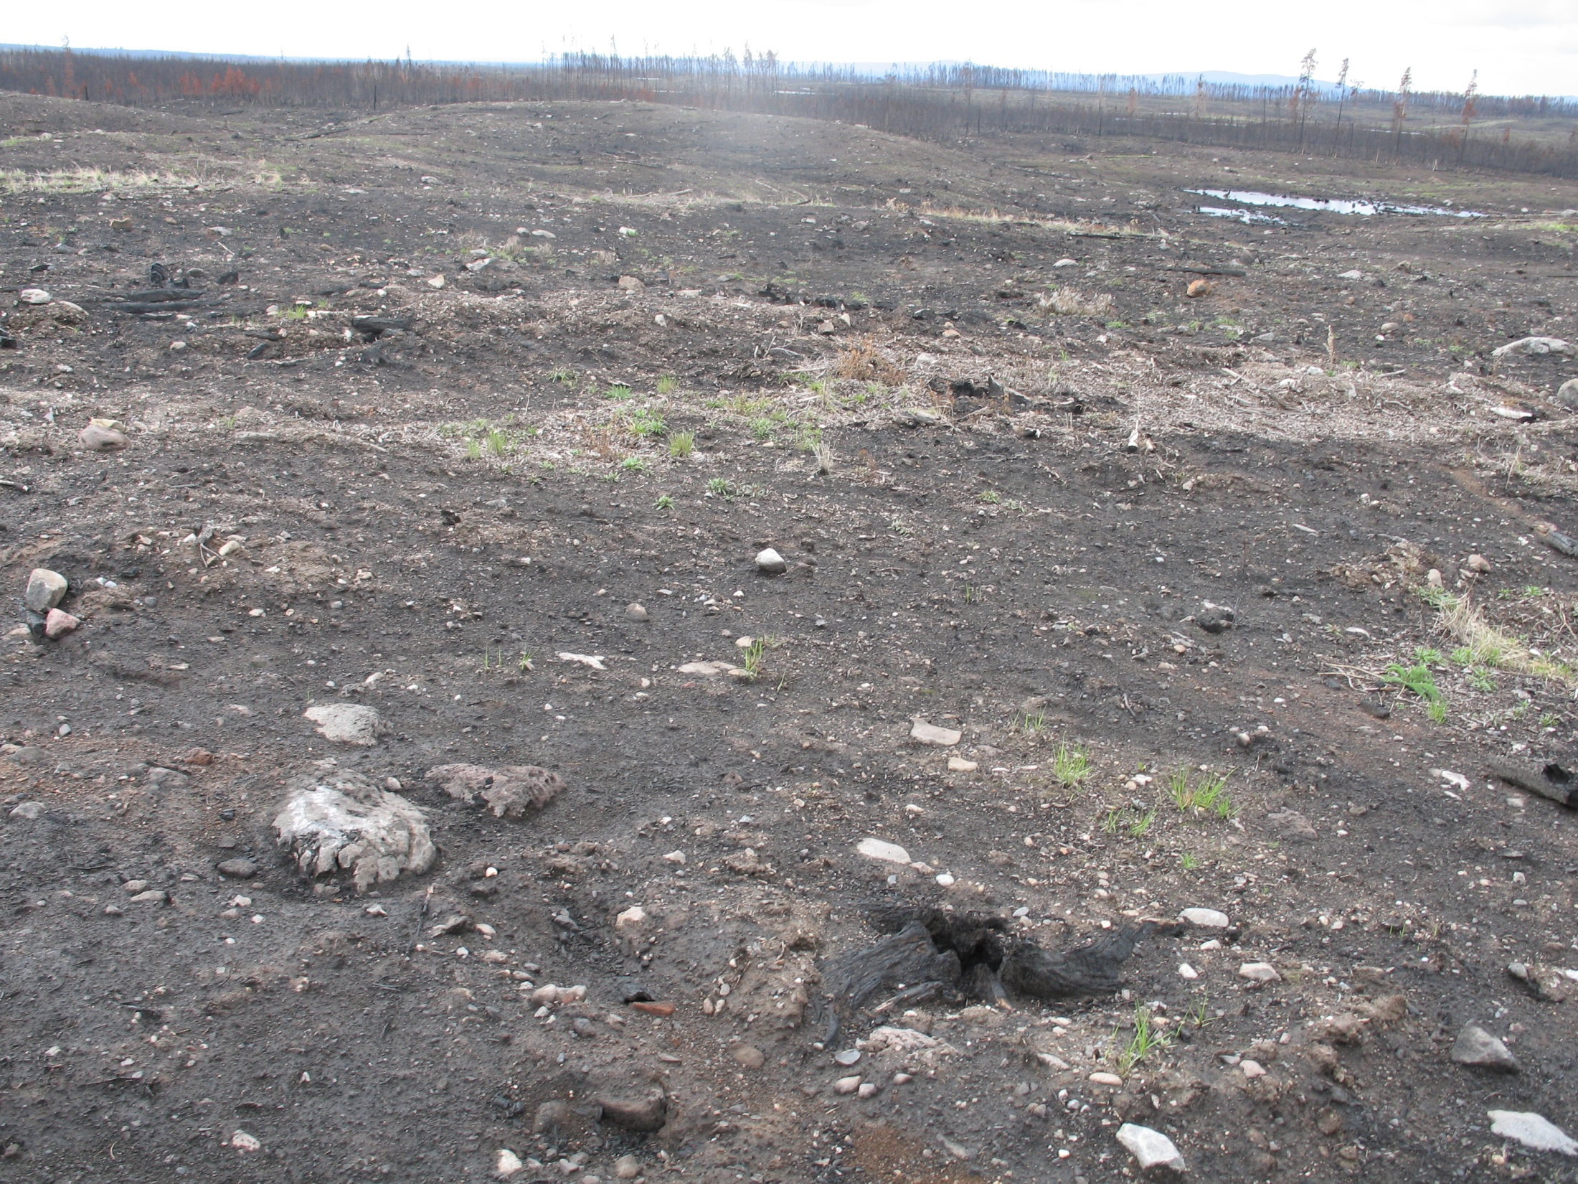
FFT created in 2005 as a response to the catastrophic wildfires of 2003 and 2004

Slide 3
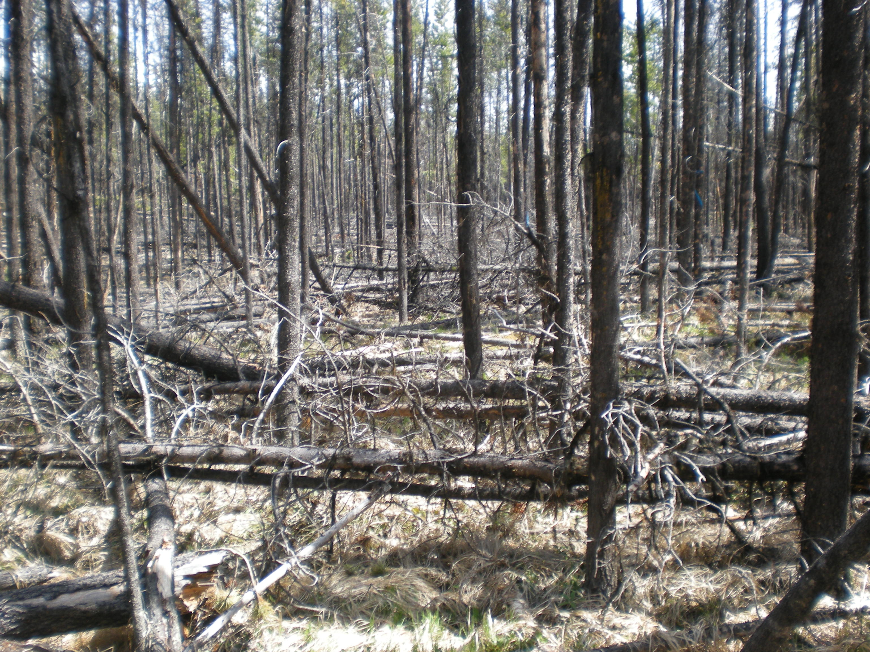
FFT has evolved to assess and treat, where necessary, forested lands that have been denuded or damaged through catastrophic disturbance or government decisions

Slide 4
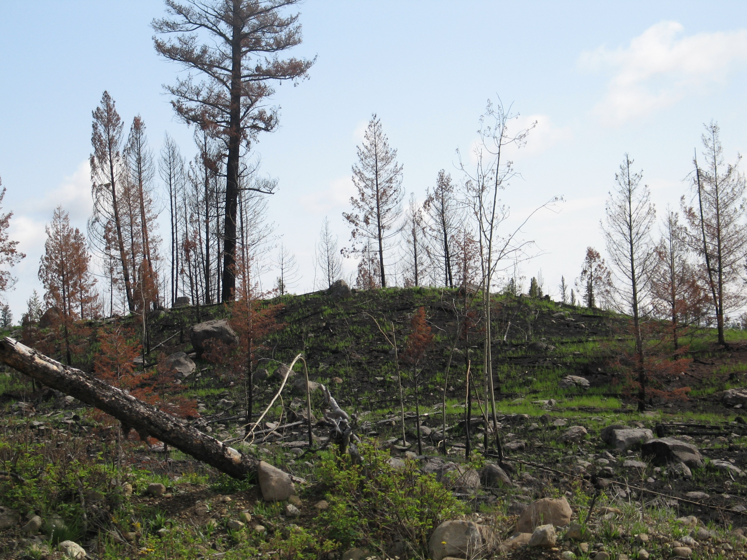
The impacts of catastrophic disturbances and constrained timber supplies are: (a) identified, prioritized and communicated to government to support investment decisions; and (b) consistent with those decisions, the impacts are effectively and efficiently mitigated by exemplary stand tending and reforestation activities that enhance forest values and support forest resilience.

Slide 5
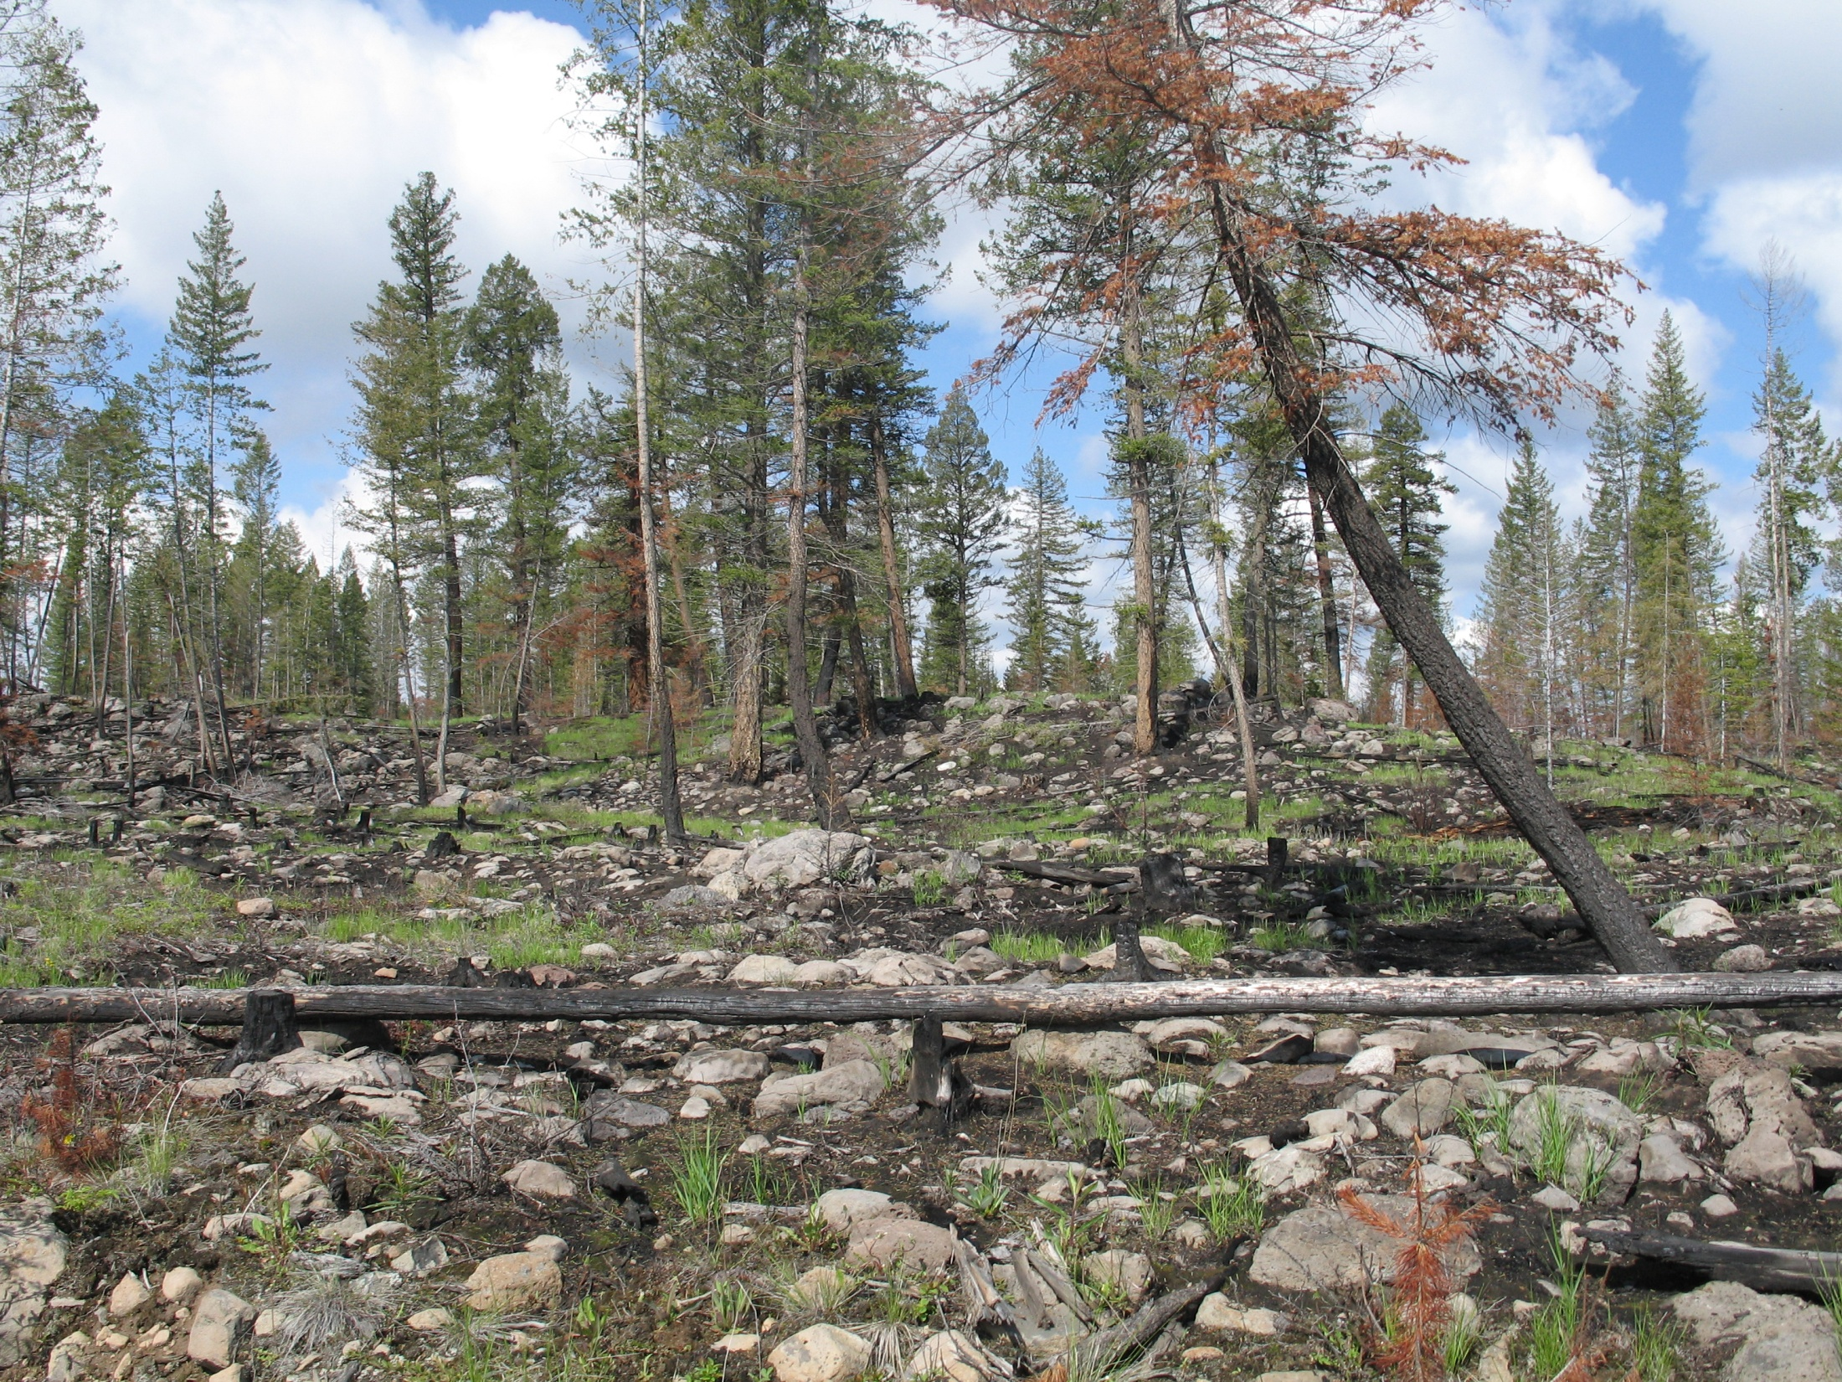
FFT optimally utilizes available funding to reforest and manage productive forest land through the use of best science, and in consideration of all forest values and changing factors.

Slide 6
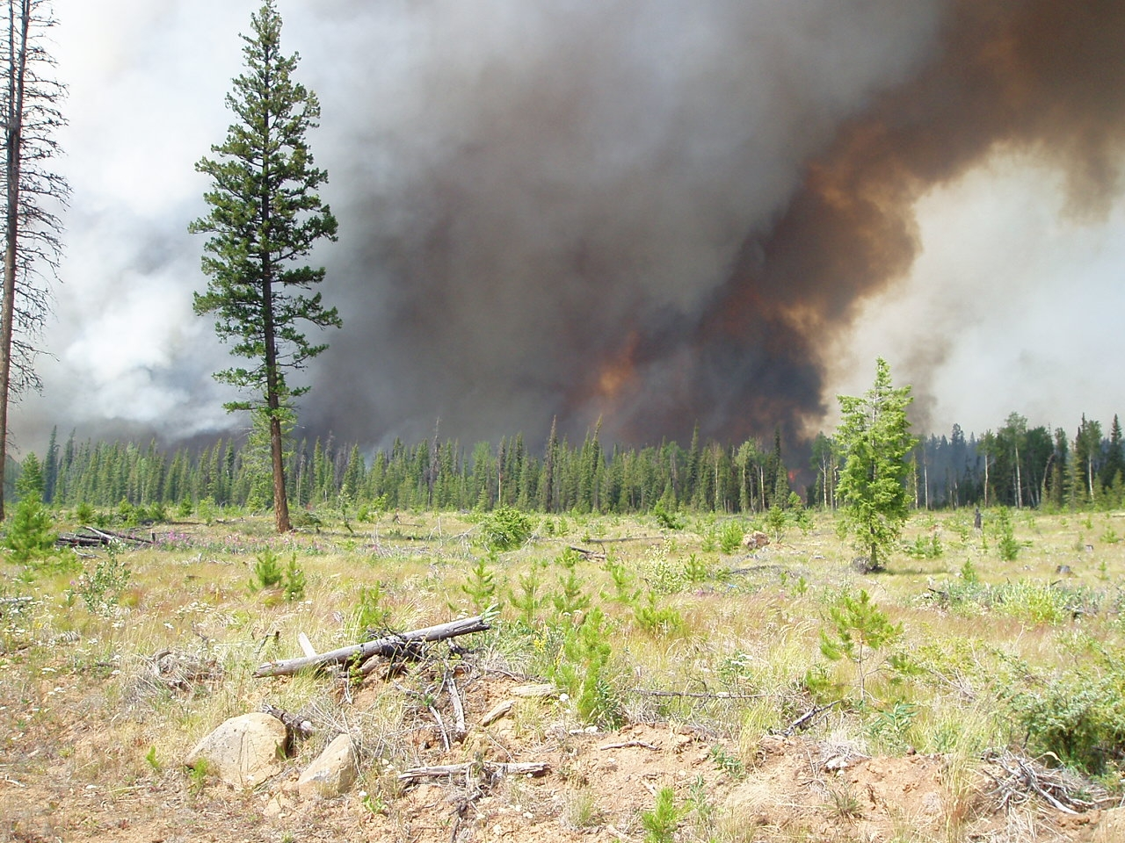
Objectives
1) Best return from investments and activities on the forest land base,
2) Encourage investments that benefit forest resources and the communities that they support consistent with government objectives
3) Provide stable, collaborative and exemplary planning, delivery and outcomes (i.e. provide leadership for other related programs, for example, by encouraging forest resilience).

Slide 7
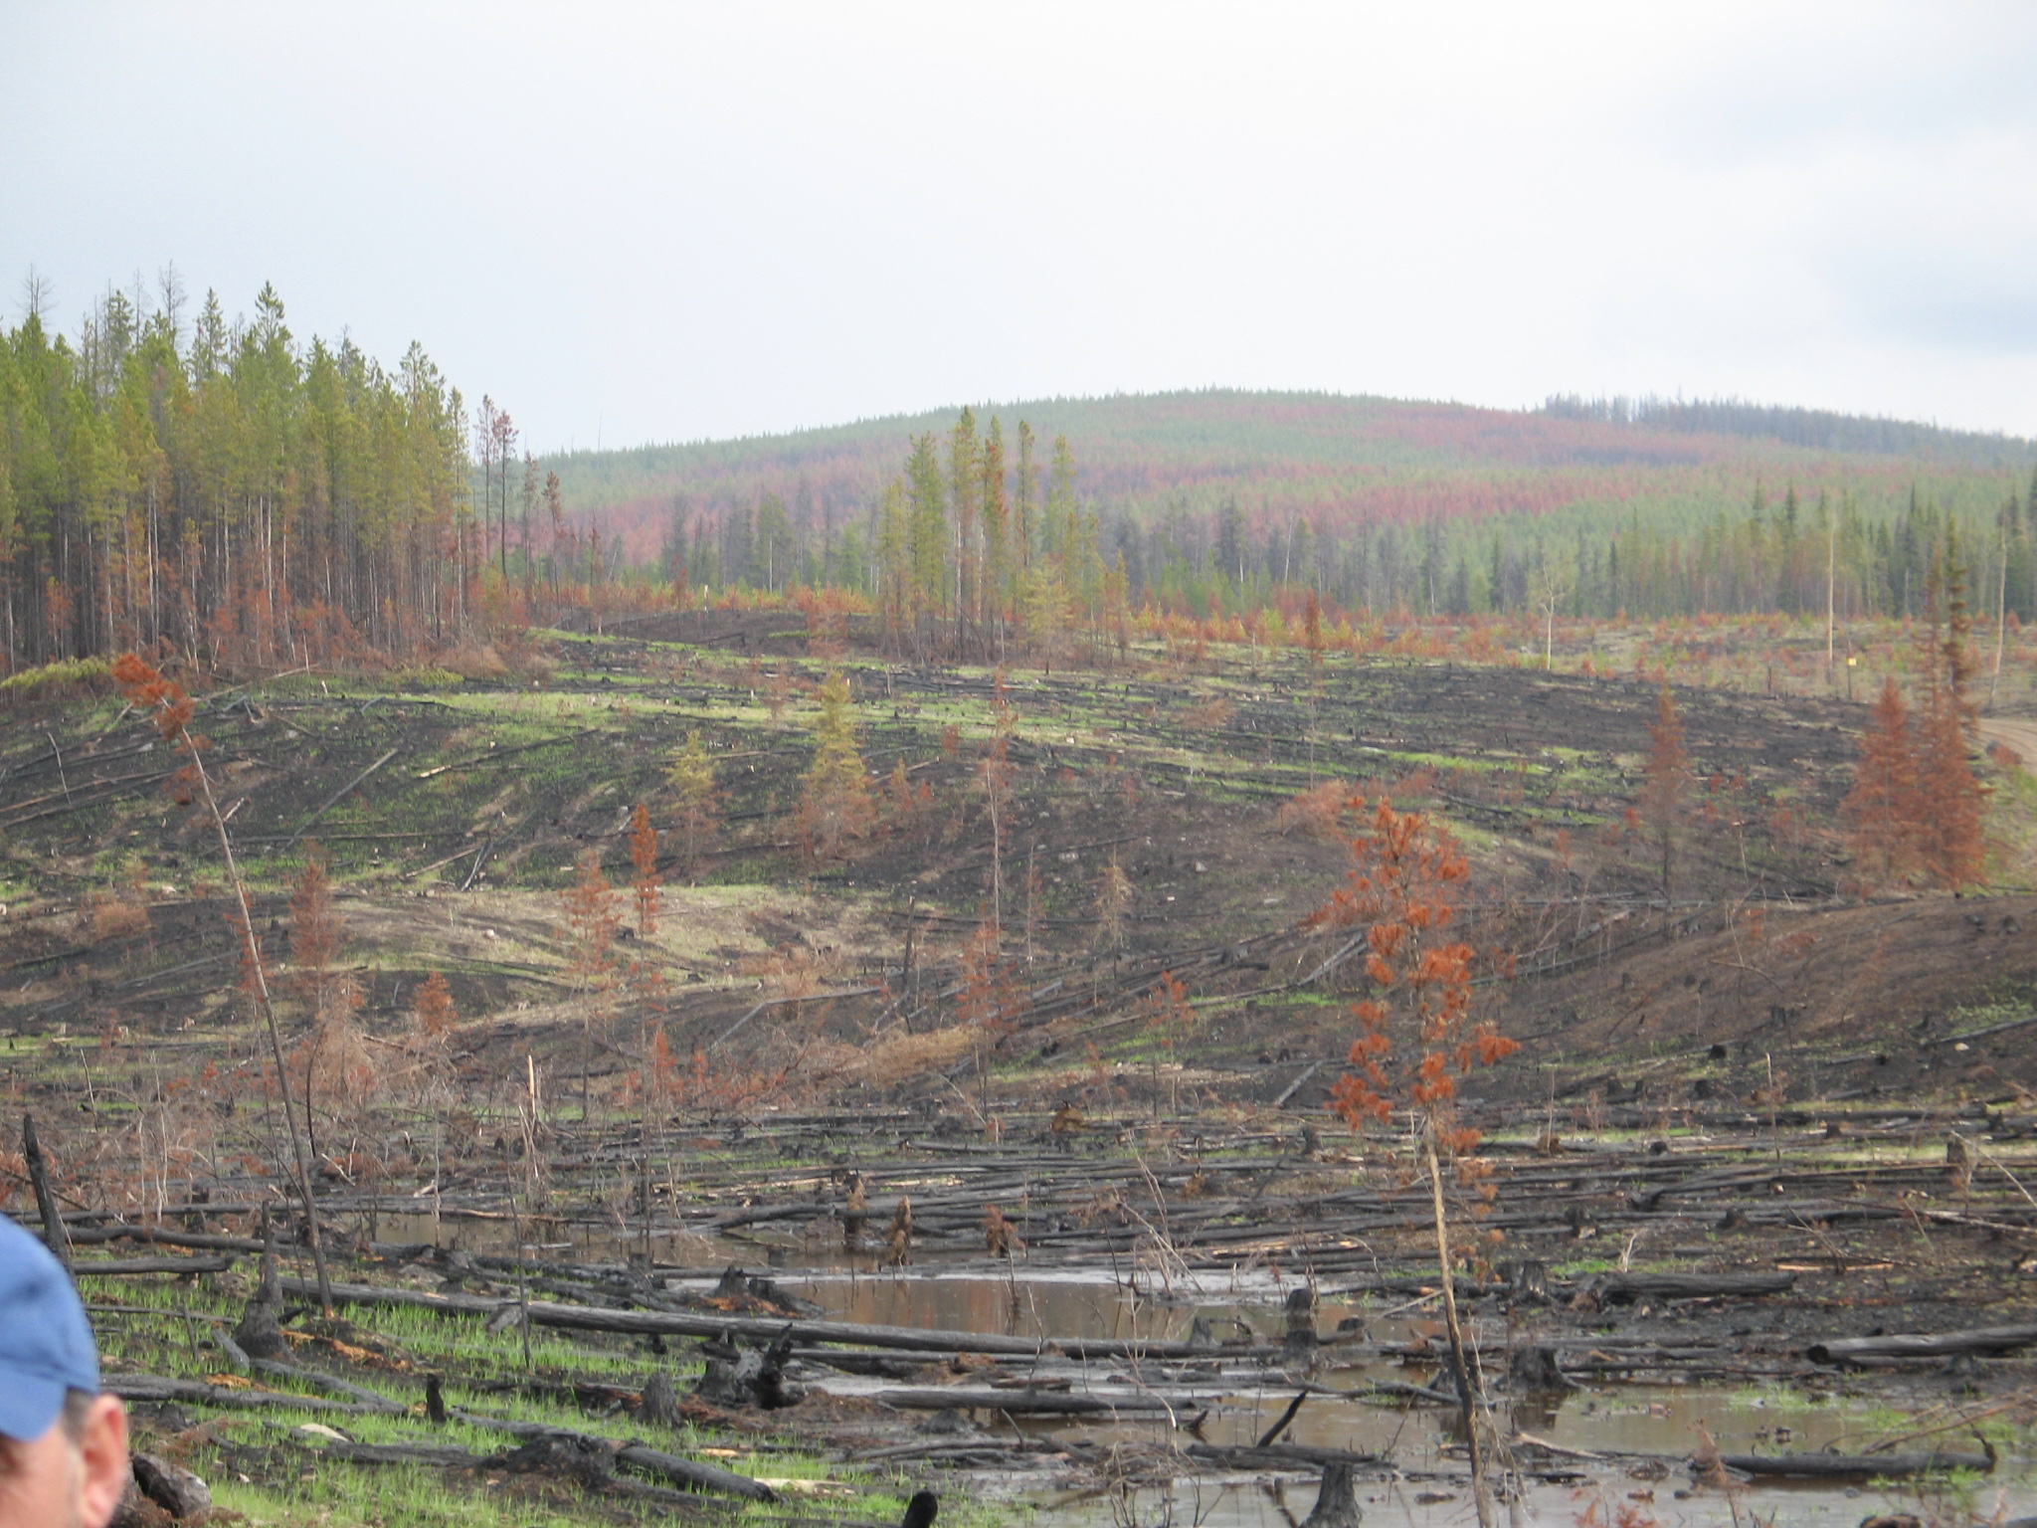
Goal 1: Informed decision-making in investing in, and delivering, reforestation and stand tending activities in an exemplary and transparent manner that improves over time

Slide 8
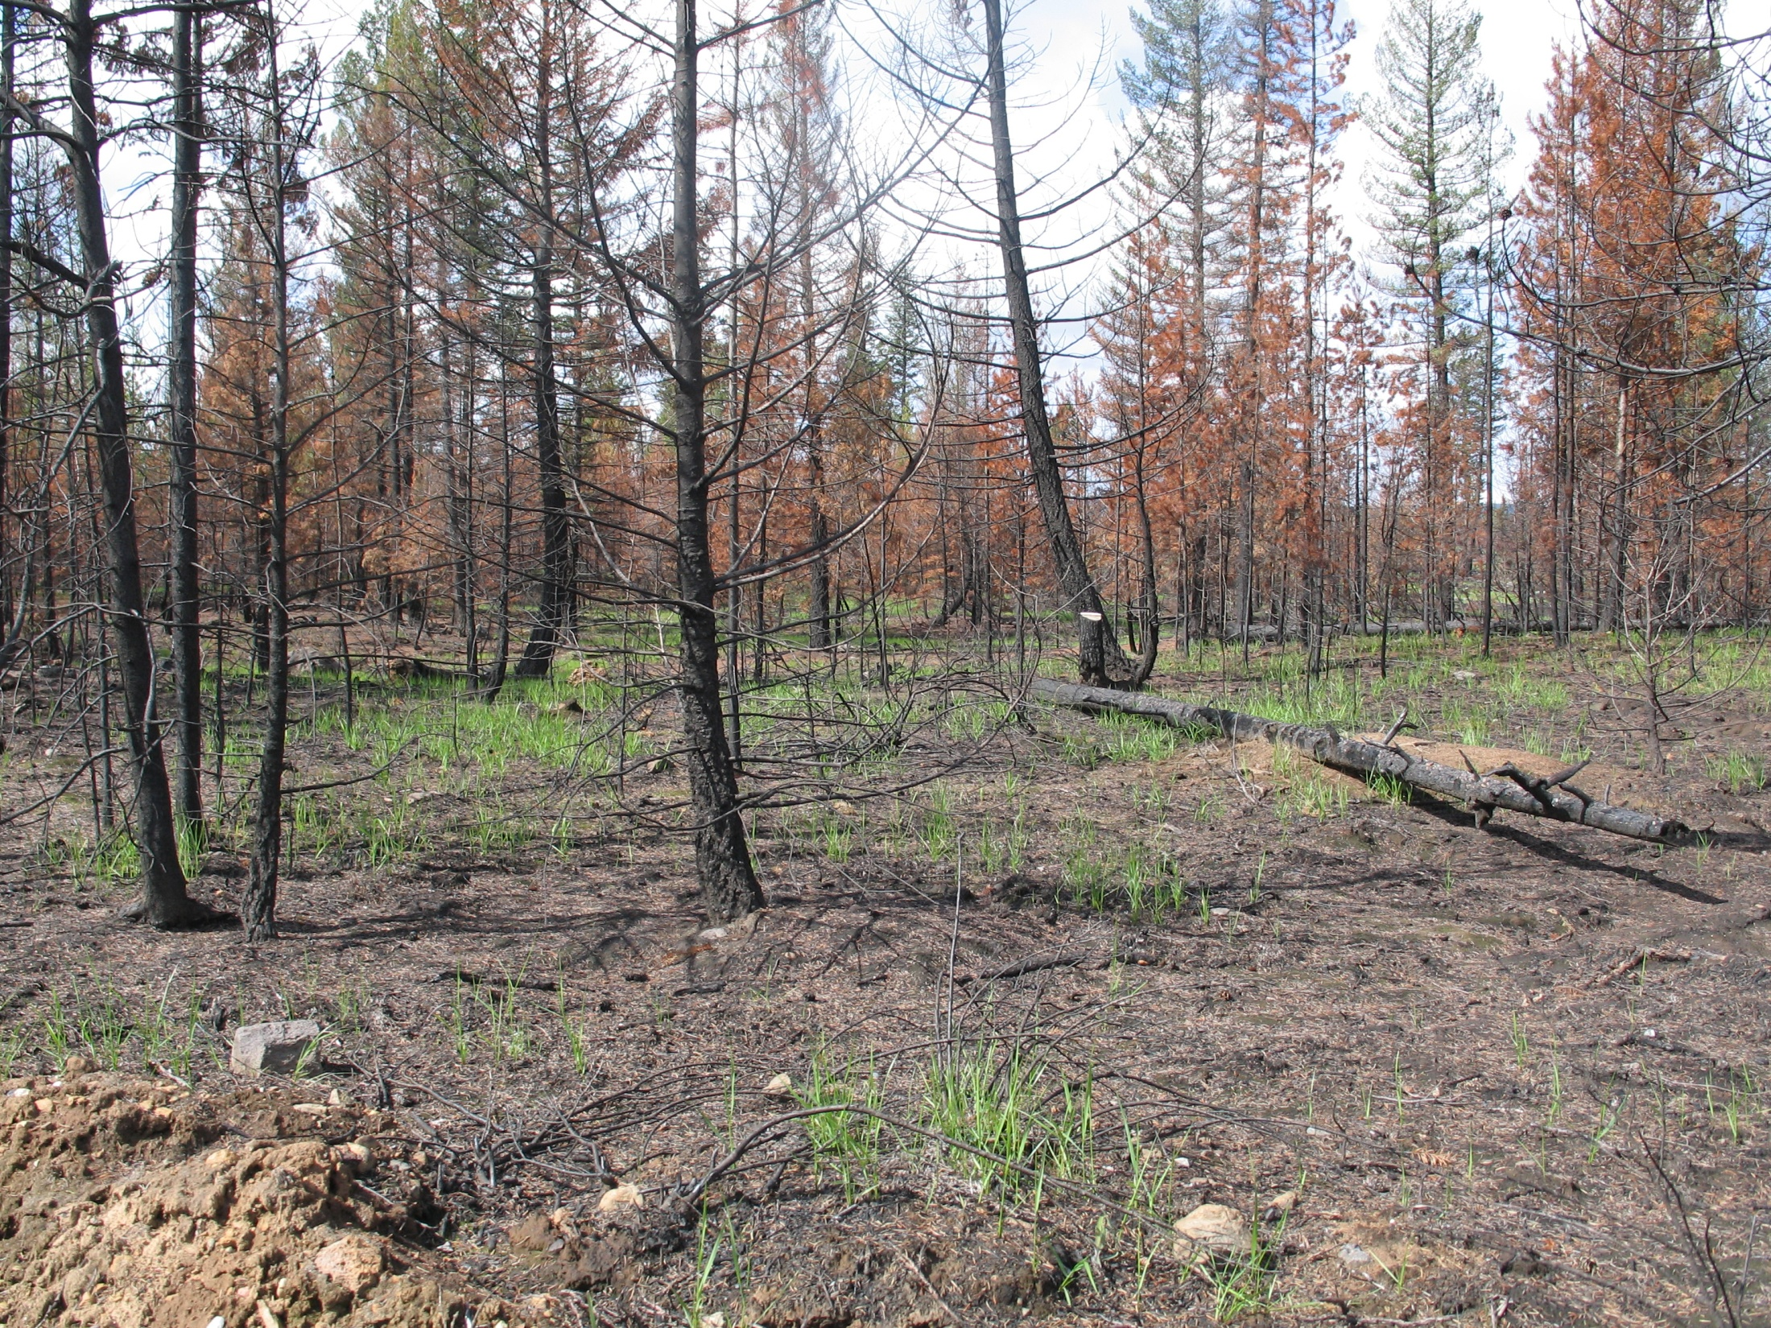
Goal 2: Improve mid- and long-term timber supply and establish resilient forest ecosystems

Slide 9
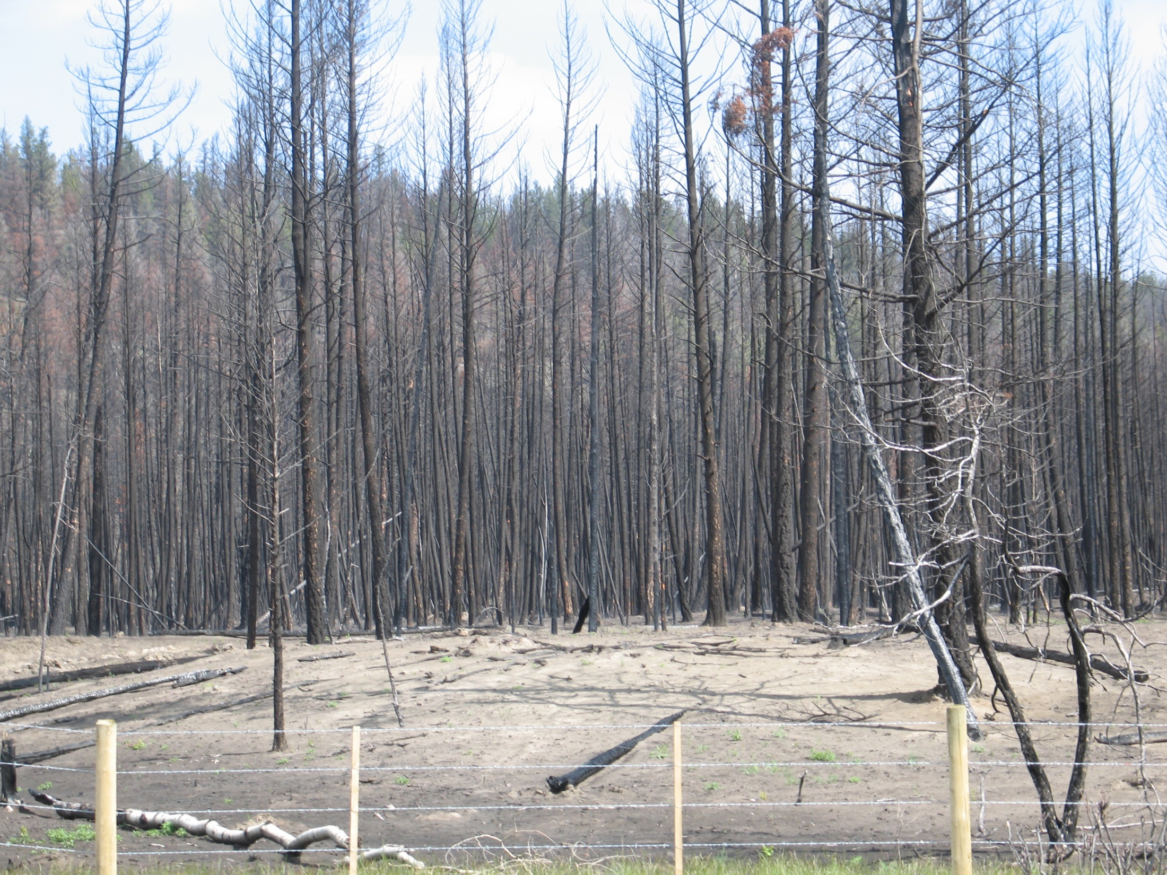
Goal 3: Best return from investments and activities on the forest land base in consideration of timber and non-timber values

Slide 10
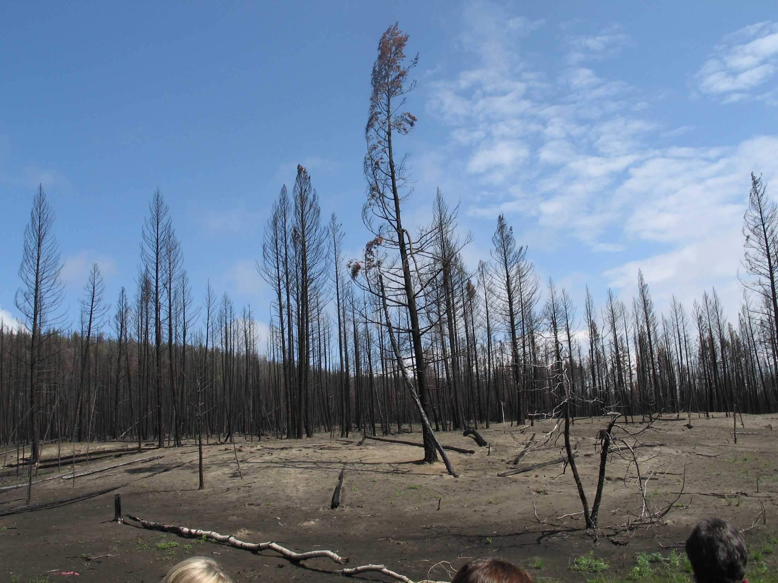
Goal 4: Safety is a fundamental component of all activities and considerations
Goal 5: People-centric approach with active communication, meaningful public engagement opportunities, and knowledgeable staff.

Slide 11
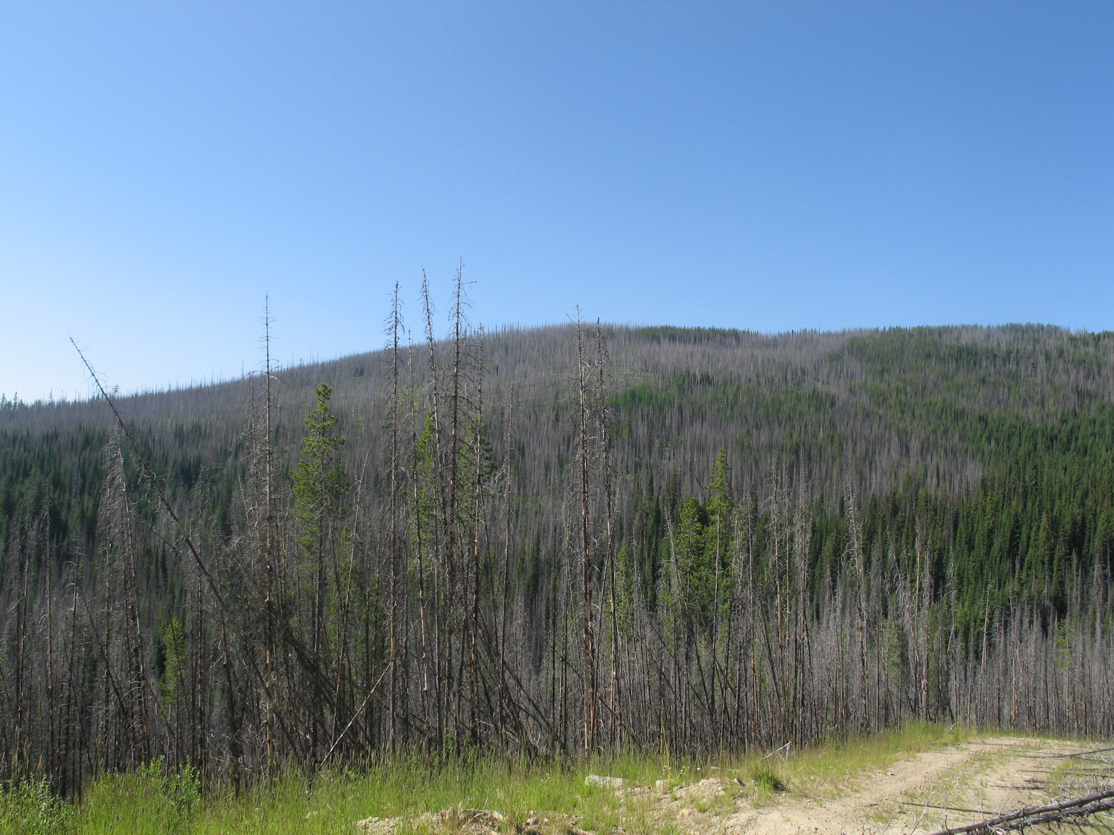
Determination of level of investment in each region of the province will be based upon the level of need and opportunity for mitigation of impacts on timber supply caused by catastrophic disturbance or constrained timber

Slide 12
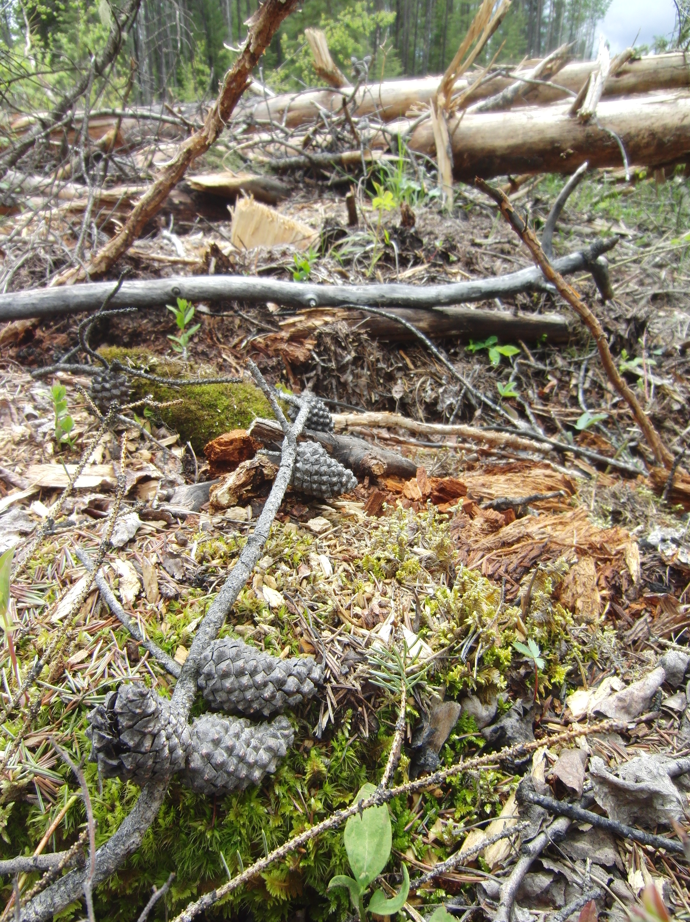
Efforts will be made in FFT to demonstrate excellence, and to be open and transparent in all aspects of the program including information sharing and decision-making.

Slide 13
